Slide 1
COGS 138: Week 8 Section
February 23rd, 2022

Slide 2
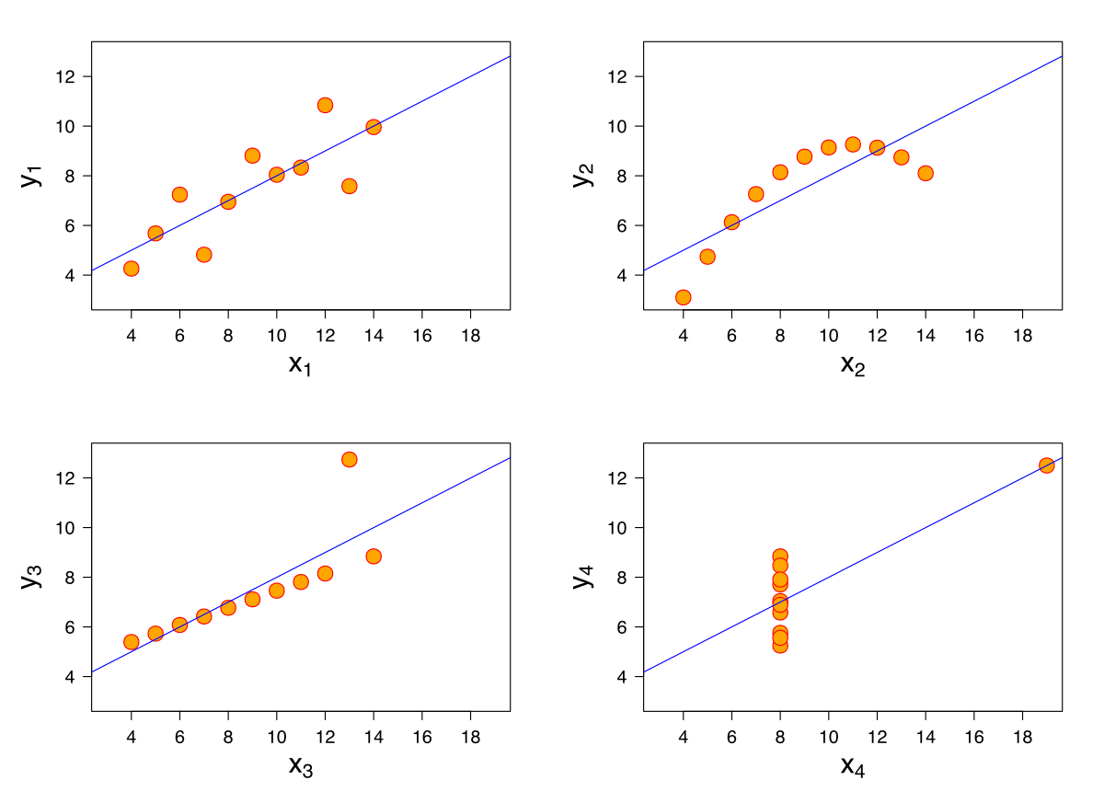
Questions about A4? (due this Friday)
Correlations
When should we vs. should we not use correlations in neuroscience research?
When is it possible to accidentally infer causality from correlation?
Tools you’ll be using:
Matplotlib (plotting library)
Seaborn (data viz library)
Scipy (stats library)
https://seaborn.pydata.org
https://matplotlib.org
https://scipy.org

Slide 3
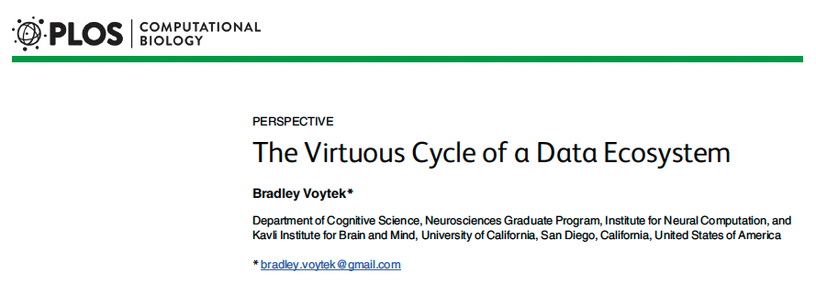
Reading #4 (last reading of the quarter!!)

Slide 4
BENEFITS
of data sharing
COSTS
of data sharing
>
Scientific replication
Collaboration
Increased citations
Data remixing
Bias minimization
Hypothesis generation
Technical and economic logistics of data storage
How to give due credit for data production

Slide 5
BENEFITS
of data sharing
COSTS
of data sharing
>
Scientific replication
Collaboration
Increased citations
Data remixing
Bias minimization
Hypothesis generation
Technical and economic logistics of data storage
How to give due credit for data production

Slide 6
“A data sharing ecosystem provides space for multiple diverse datasets to intermingle to encourage new, multidisciplinary discoveries for current and future scientists.”

Slide 7
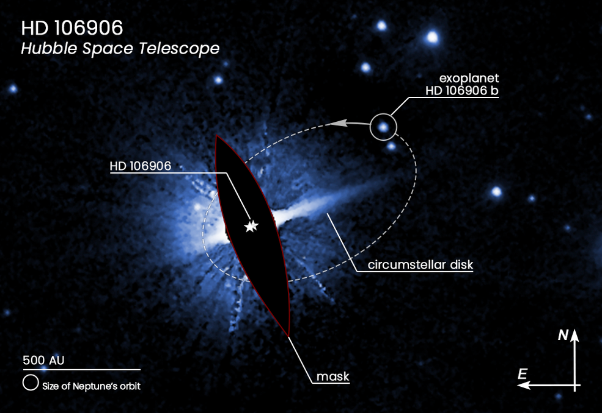
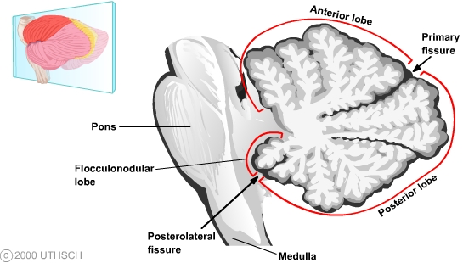
Data Sharing Benefits
1. Reanalyze OLD data using NEW methods
2. Text mining
3. Data remixing and combination
4. Semi-automated / algorithmic hypothesis generation
Summer et al., 2011; Dalal et al., 2013
Notes:
1. Reanalyzing old data using new methods. Exoplanets were discovered in decades-old
data collected by the Hubble Space Telescope [16]; 19th century naval logbooks were used to
extract weather data to model climate change [17]; epigenetic changes in DNA methylation
were identified as a function of prenatal exposure to famine as documented by health records
preserved from the 1944–45 Dutch Hunger Winter [18]; ink traces of electrophysiological data
collected from the human cerebellum in the 1930s and 1940s were digitized and analyzed using
modern methods to uncover novel functions of this brain region [19].

Slide 8
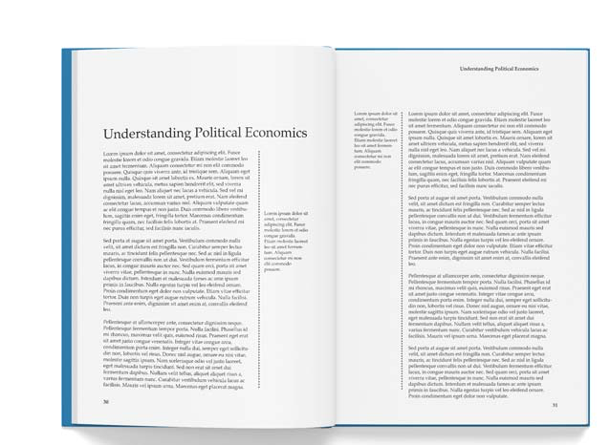
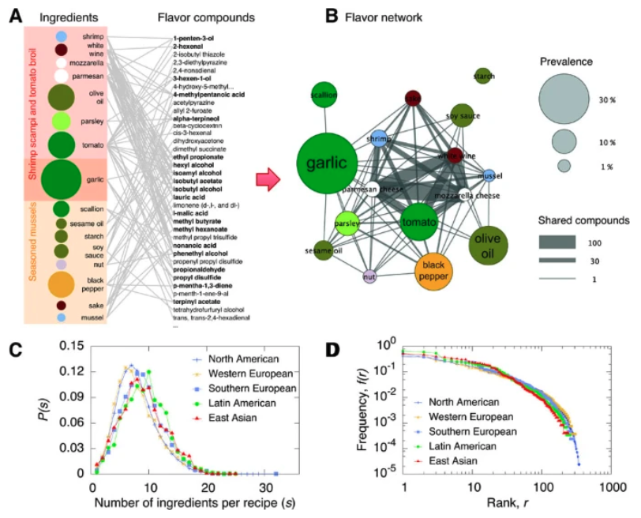
Data Sharing Benefits
1. Reanalyze OLD data using NEW methods
2. Text mining
3. Data remixing and combination
4. Semi-automated / algorithmic hypothesis generation
Ahl et al., 2011
Notes:
2. Text mining for scientific discovery. Text was extracted from millions of books published
across hundreds of years to model language evolution and cultural phenomena [20,21];
freeform text from patients writing in online forums was analyzed to aid in clinical discovery
[22]; online food recipes were used to uncover cultural taste preferences [23].

Slide 9
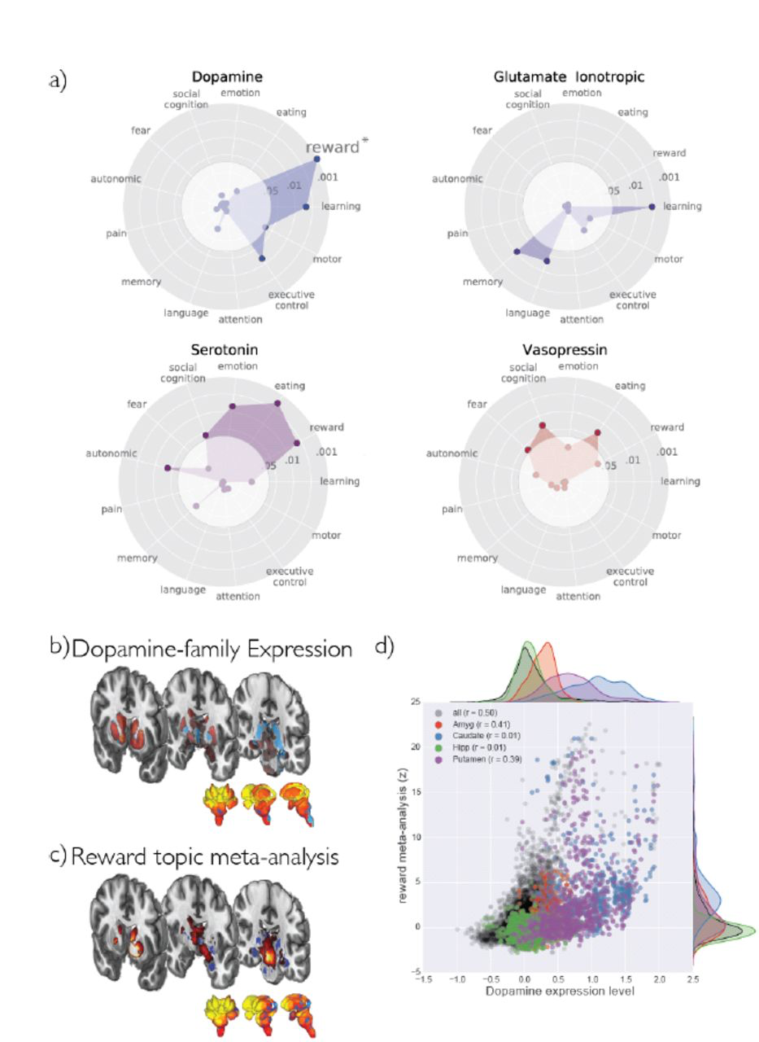
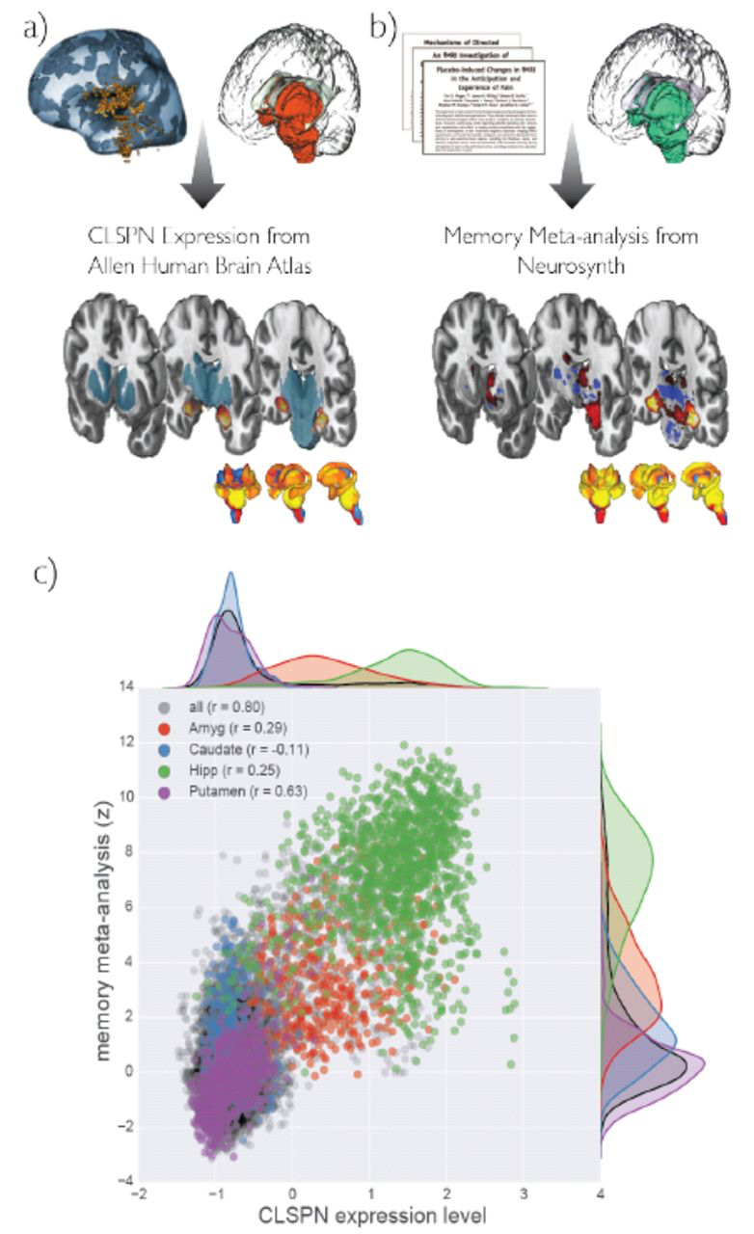
Data Sharing Benefits
1. Reanalyze OLD data using NEW methods
2. Text mining
3. Data remixing and combination
4. Semi-automated / algorithmic hypothesis generation
Fox et al., 2014
Notes:
3. Data remixing and combination. Data from studies in archeology, criminology, economics,
geography, history, political science, and psychology were used to analyze the effect of
climate on human conflict [24]; neuroscientific textual information from millions of peerreviewed
papers was compared against human brain gene expression data to identify brain
structure, function, and disease relationships [25]; spatial information about the functional
relationships of the human brain, as mined from thousands of peer-reviewed papers, was combined
with spatial information on human gene expression data to identify novel gene—cognition
relationships [26].
The Neurosynth-gene atlas uses spatial associations to link genes to cognitive processes, and is exemplified here by CLSPN gene expression from the AHBA and Memory meta-analysis map in Neurosynth
Neurotransmitter-genes are selectively associated with Neurosynth topics

Slide 10
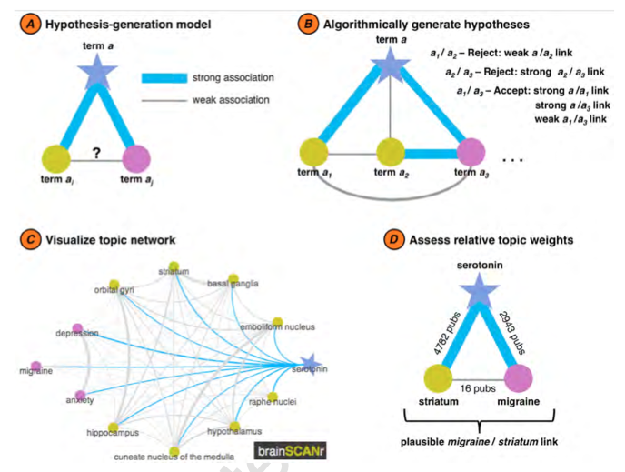
Data Sharing Benefits
1. Reanalyze OLD data using NEW methods
2. Text mining
3. Data remixing and combination
4. Semi-automated / algorithmic hypothesis generation
Voytek & Voytek, 2012
Notes:
4. Semi-automated, or algorithmic, hypothesis generation. Neuronal electrophysiological
data were aggregated to study neural diversity [27,28]; research maps of experimental
results were created to extract the weight of evidential support or results [29]; possible novel
hypotheses were uncovered by analyzing missing connections between scientific topics
[25,26,30].

Slide 11
Bias minimization
Increasing generalizability by decreasing sampling biases
Broad access to raw data → greater potential for multiple cultural interpretations
Current meta-analyses are limited
Summary statistics = massive data reduction
GOAL: “...democratization of the scientific process through citizen science…”

Slide 12
General Announcements and Reminders
A4 (Correlations) due this Friday (2/25/22) at 11:59 PM (PST)
Post in slack with questions
Reading Quiz due next Friday (3/4/22) at 11:59 PM (PST)
Reading quiz released TOMORROW
Three attempts
We will grade your last attempt, not your best attempt

